Slide 1
Final Presentation
By Anmol Dash

Slide 2
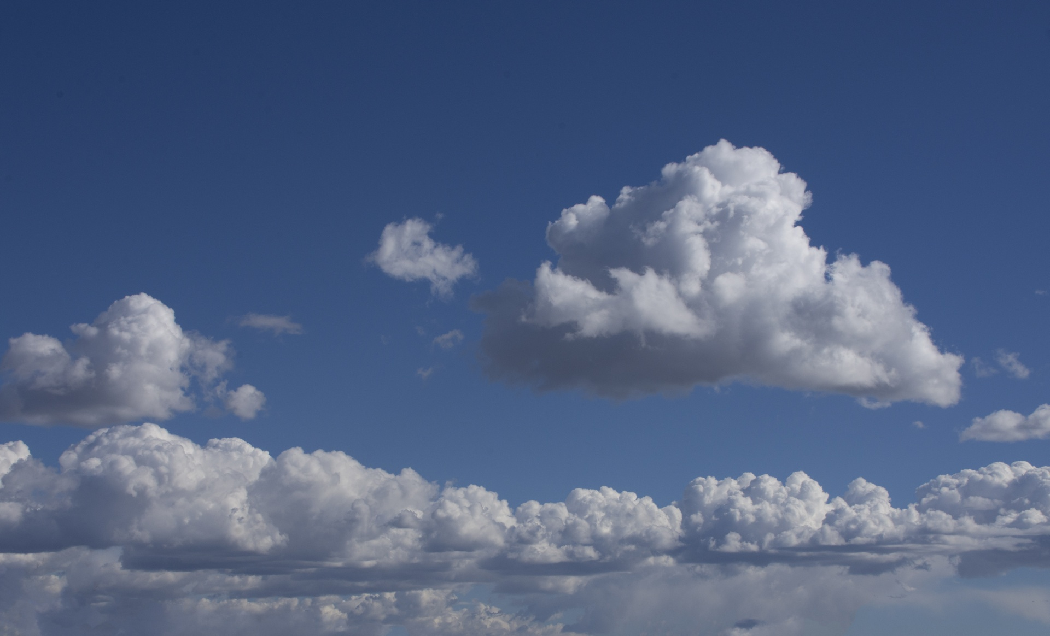
What is my project?
See what can be found from ASOS station data
Try to find the connection between regular images and thermal images- could we interconvert the two without the thermal data, just the dates/times? With meteorological data?
Can we find anything else from the thermal images and corresponding data?
What else can we predict using machine learning?

Slide 3
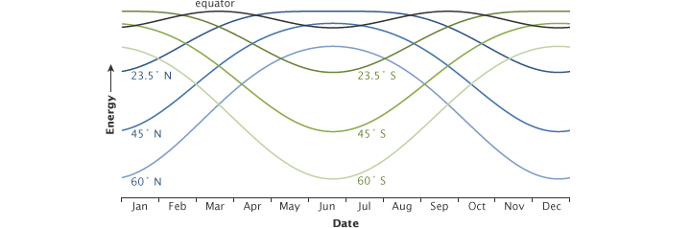
What is CCL/LCL and solar irradiance?
LCL(Lifting Condensation Level)
Requires lifting of the air parcel
Height at which the relative humidity of an air parcel reaches 100%.
Can be used to estimate the height of a cloud base
Specifically, the LCL Pressure and Temperature were calculated
Solar irradiance
Output of light energy from the total disk of the sun
Global irradiance is the total amount
Net irradiance is the amount that actually reaches the surface

Slide 4
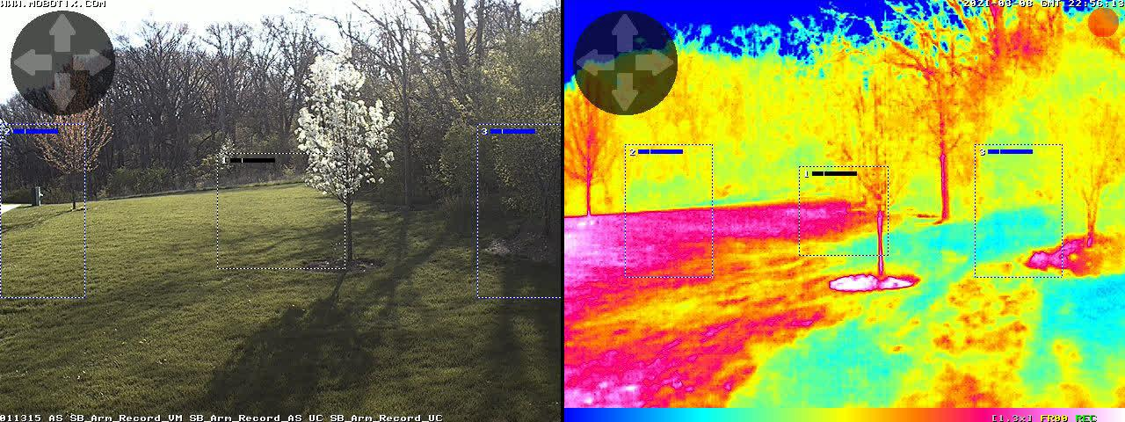
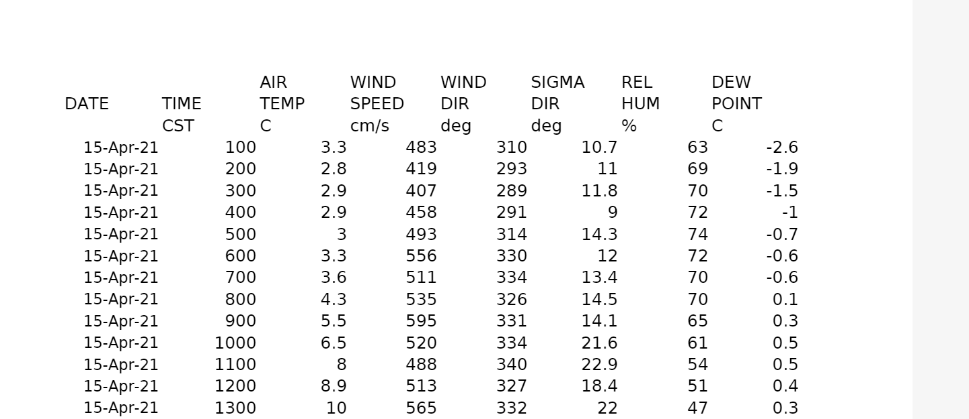
Tools
ASOS(Automated Surface Observation Systems) Data
Two datasets, both taken near Argonne(O’Hare)
Larger one from 2010-2020(100k entries),
Hourly Visibility
Hourly Wind Speed and Direction
Hourly Sea Level Pressure
Relative Humidity
Hourly Wet Bulb Temperature
MOBOTIX Data
Pictures taken hourly from 4/15 to 4/25
Corresponding thermal and regular images
Corresponding temperature arrays
Solar irradiance data taken hourly from 4/15 to 4/25 using the pyrometer at the lab.

Slide 5

ML Techniques
Pytorch
Used to link the images(thermal and regular)
Test a neural network to create
Tensorflow(new)
Used to link ASOS data and temperature arrays
Did not use LGTM model

Slide 6
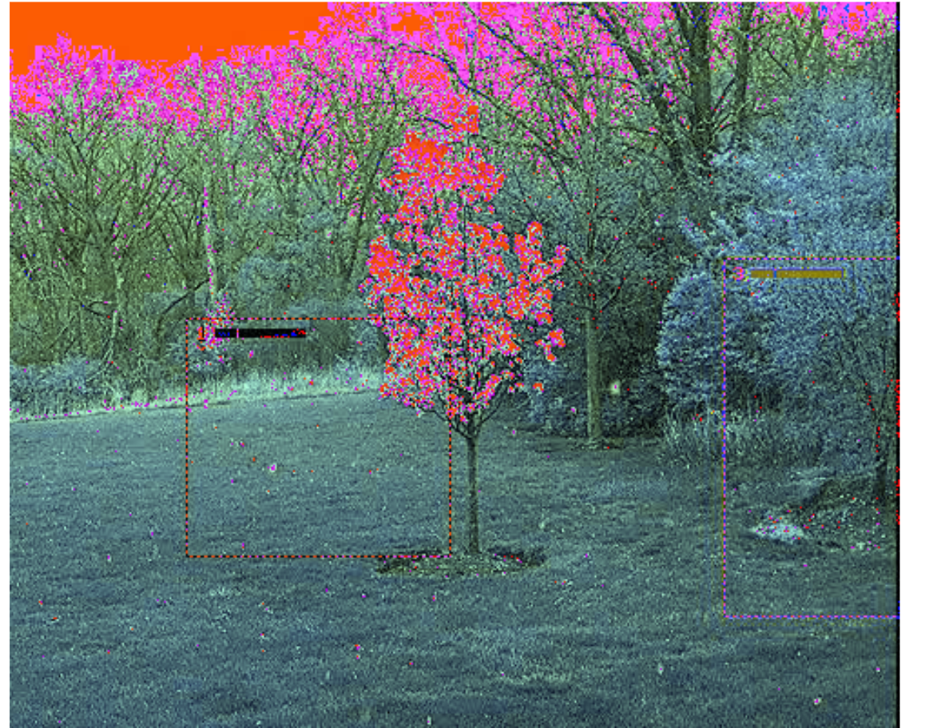
Thermal imaging
Using date and image, tried to generate an approximation of the corresponding thermal image
Array of 252x336 temperature values
Largely unsuccessful- no way to re-engineer the thermal image from the actual image
Even with added meteorological factors, there was no correlation that could be determined
Used Pytorch

Slide 7
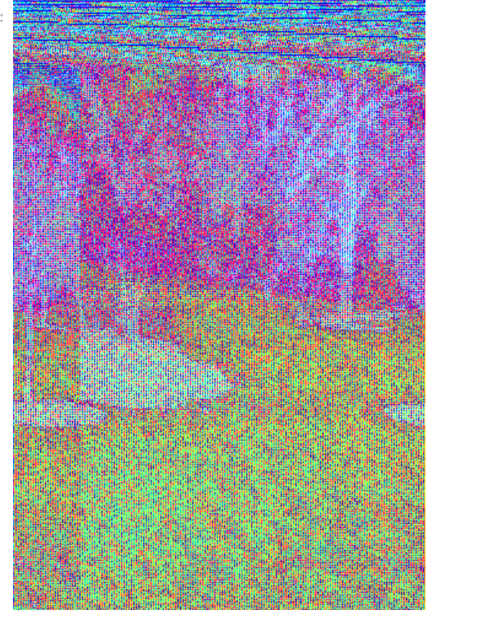
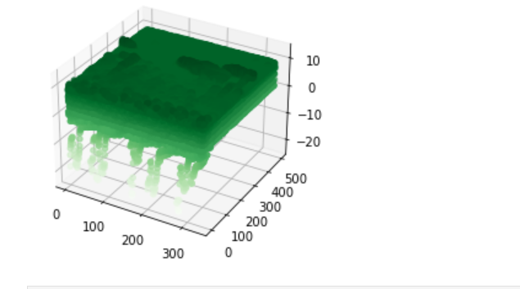
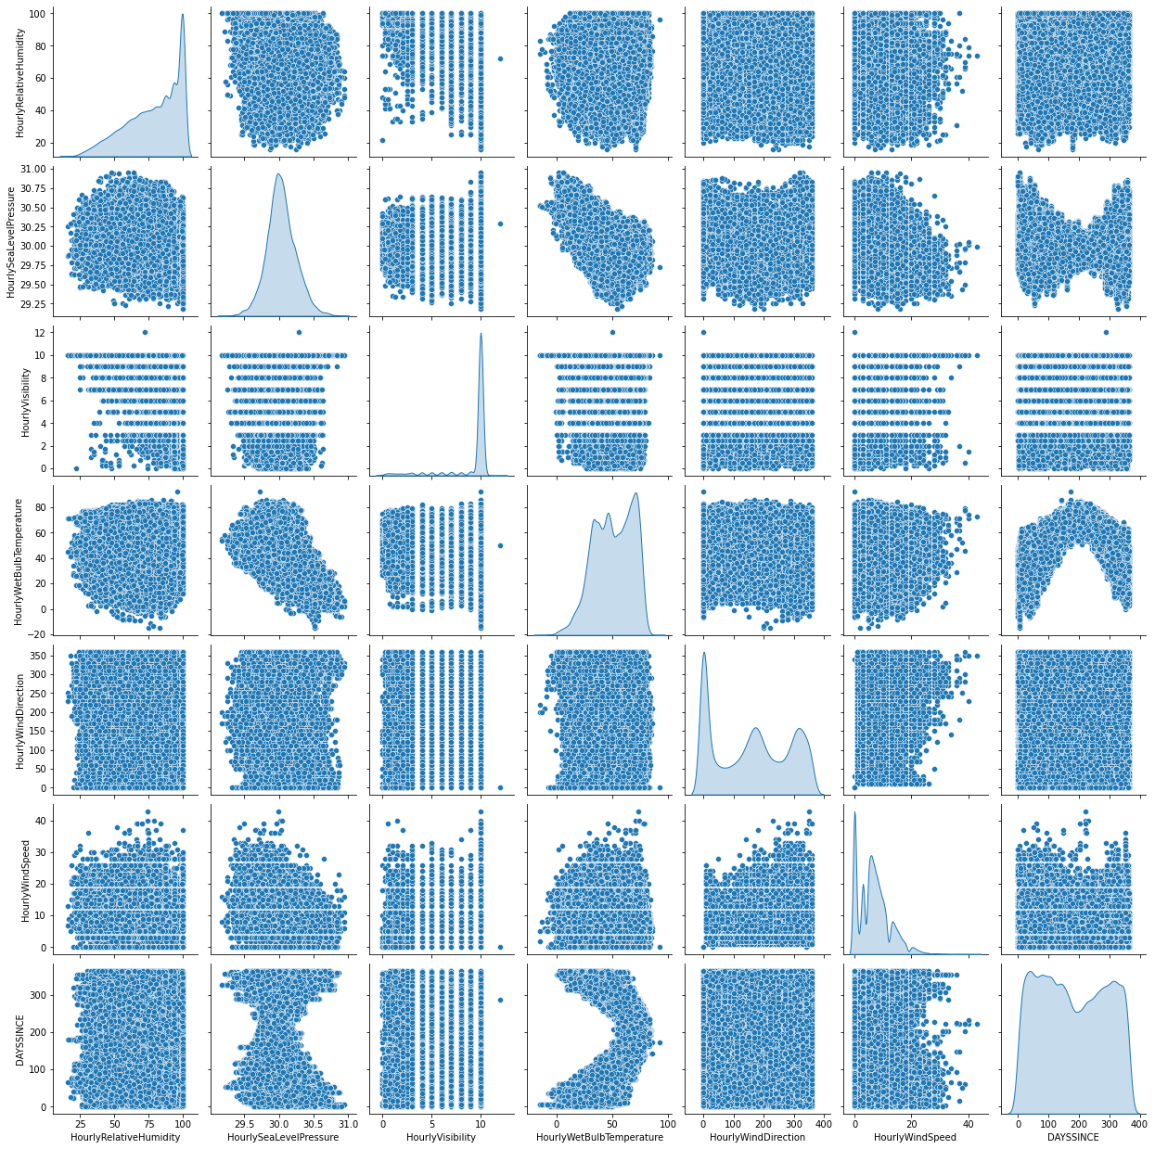
LCL Calculation
Created image out of thermal CSVs(over period from 4/15-4/21) this year to determine which temperatures correspond to which parts of the image
Used Keras Functional model to use thermal csv inputs
Without thermal image data, LCL Pressure cannot be calculated
Thermal image data interferes with LCL Temperature calculation(only need Sea Level Pressure, humidity,and Wet Bulb Temperature)
Specific areas of the thermal image rarely aid in calculation of LCL- whole image needed)
Accuracy for both reaches 99%
Created code for plugin

Slide 8
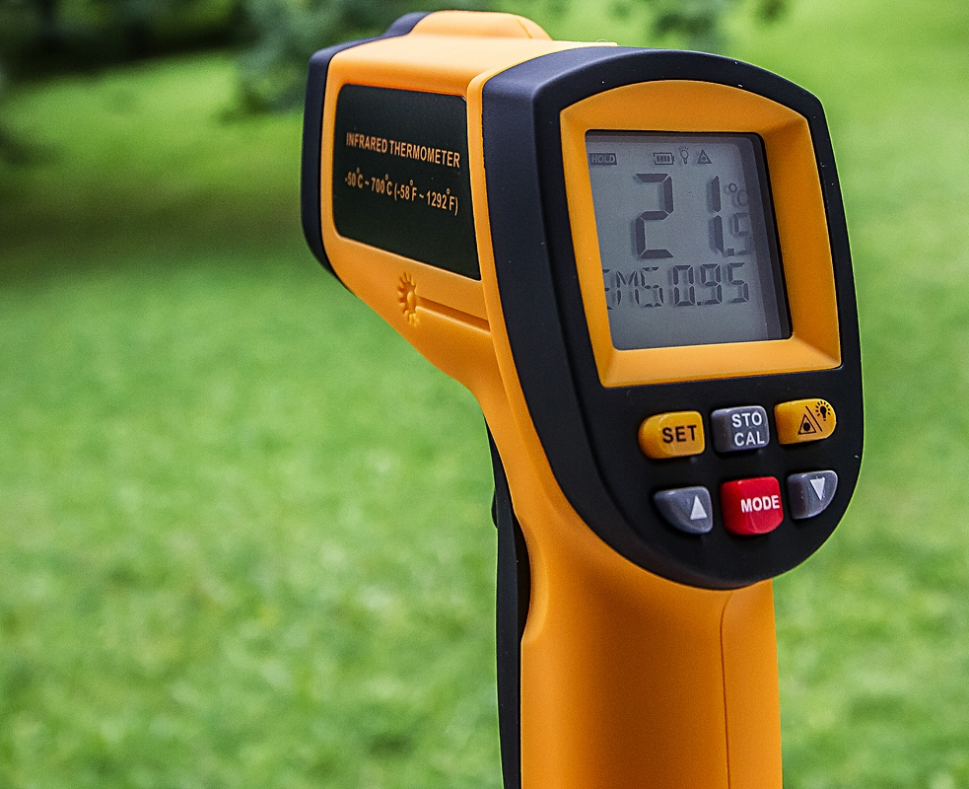
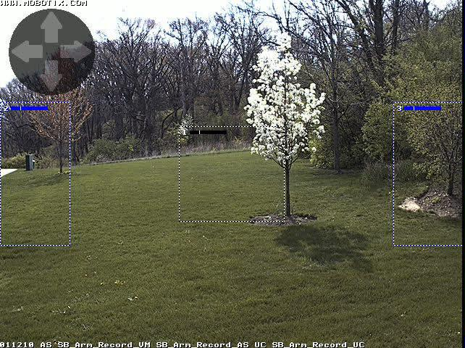
Solar Irradiance Data
Taken from pyrometer at Argonne
Hourly data over the same period
Relevant features were
Wind Speed/Direction
Air Temperature
Relative Humidity
Sigma Direction
Dew Point
Barometer Pressure
Precipitation
The types of irradiance measured were global and net

Slide 9
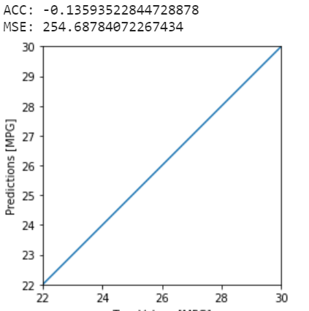
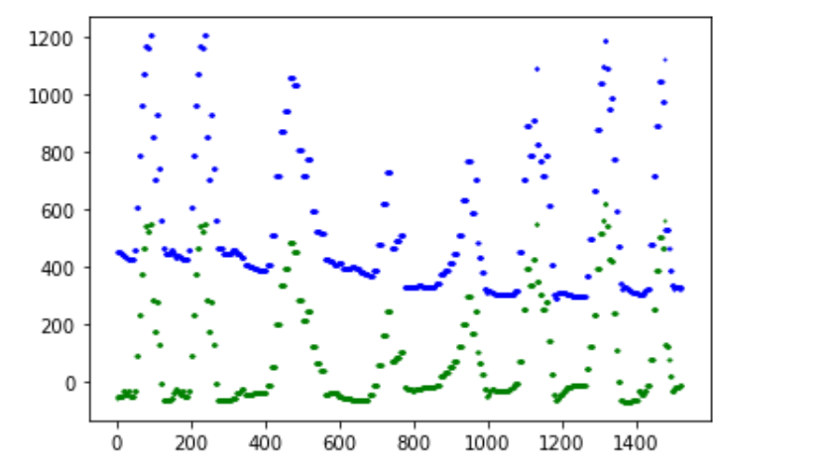
Machine Learning models
Pytorch Model
6 hidden layers
.01 explained variance score
2876.4 MSE
SGD optimizer
.0001 = learning rate
Same for global radiance and net radiance
With the exception of the final parameters, no other tensorflow model architectures worked

Slide 10

Final Model
Tensorflow(Keras) Functional
2 processing layers for each input(thermal image and weather data)
5 hidden layers after concatenation
Batch size = 64
Validation Split = .2
koss= Mean absolute error, optimizer=Adam
Final accuracy around 91%
Highest was 92.5%
MSE was 48.67
Used the same features as before
Very similar model overall to the LCL one
Both models can be used to predict meteorological information with basic data

Slide 11
Thanks for listening!

